Slide 1
State Diagrams & Extras
Game 253

Slide 2
Introduction
Explaining a State Diagram
State Diagram Symbols
Multithreading
ECS

Slide 3
State Diagrams
What are they good for

Slide 4
What is a State Diagram?
State Diagrams are also known as State Machines, or State Machine Diagrams
They are a behavioural diagram, that describe how a state machine responds to conditions
Can be used to:
  Document events in an event driven system
  Document the flow between states of a state based entity

Slide 5
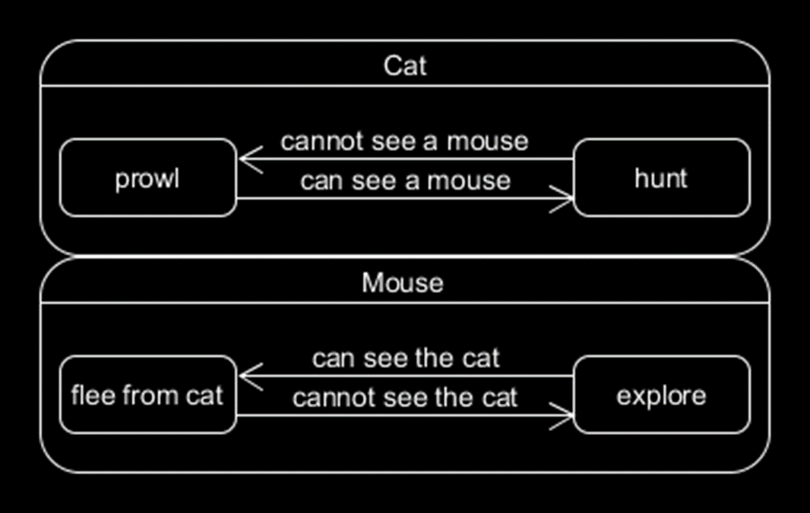
Building a Diagram
Let’s try to capture the states and conditions in a game of Cat and Mouse.
At first, we may come up with something like this diagram.

Slide 6
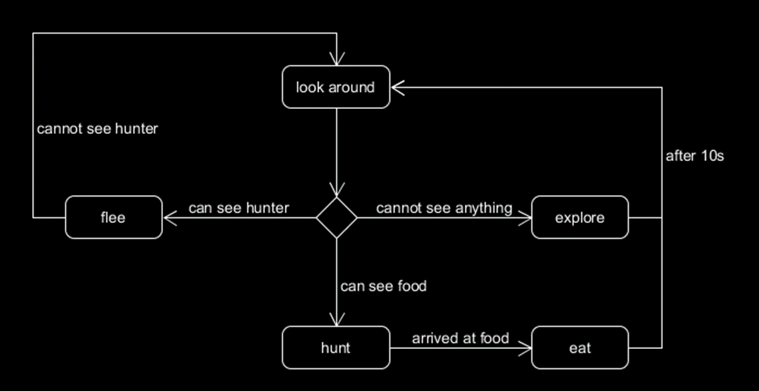
Improving a Diagram
If we generalise these states, we could come up with a state machine that describes both Cat and Mouse.
More accurately this State Diagram describes 4 states that each can transition to each other given a variety of conditions.

Slide 7
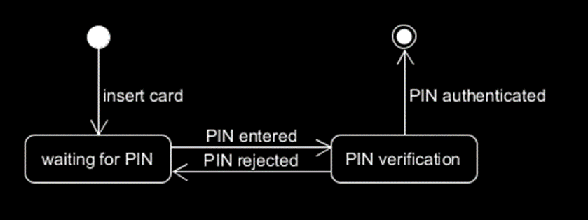
ATM Starting States Example
Stars at the black circle (Initial State / First State)
Transition to waiting for PIN when card is inserted
Transition to PIN verification when PIN is entered
Transition to waiting for PIN if PIN is rejected
Transition to Terminator when PIN is autheticated

Slide 8
Symbols
And how to use them

Slide 9
Symbols of a State Diagram
You will probably find, if you haven’t already that we know most of these symbols already, as a State Diagram very closely resembles an Activity Diagram.

Slide 10

Initial State
The initial state is the starting state of the state diagram
Same as an activity diagram

Slide 11

State
States define the current behaviour of the object

Slide 12
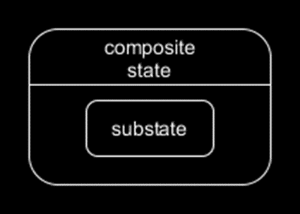
Sub-State
Sub-States are states within composite states
By placing a State Diagram inside the Composite State we define in detail the various sub-states of the composite
(We will go over this in more detail next week)

Slide 13
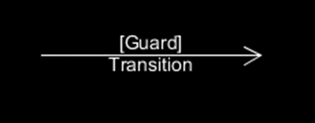
Transition / Flow
Transition mark events that cause one state to switch to another
Transitions can have a ‘Guard’ which is a Boolean condition that allows or prevents transition

Slide 14

Trigger
Triggers are labels on transitions that define the event that causes the transition
In this case hunt transitions to eat when arrived at food

Slide 15

Decision
Defines a pseudo-state that can branch to multiple states

Slide 16
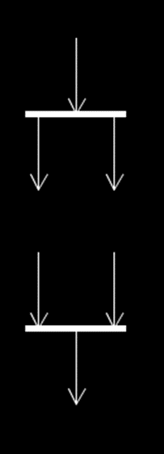
Synchronisation
Much like Activity Diagrams whenever multiple states can occur simultaneously a fork is used to branch transitions
Fork (Top)
  Splits a transition into multiple states (at the same time)
Join (Bottom)
  Rejoins separate flows of states together (only used at the end of a fork to show that flows have been synchronised)
These are not decisions these are for multi-threading or similar concurrent operation procedures

Slide 17

Terminator (I’ll be back)
The end state, defines when the state machine finishes

Slide 18

Exit Point
An exit point defines when the state machine exits, but wouldn’t have been classified as finishing
This is an early exit node
Use this when trying to say that while the state machine has now ended, it did not end in the desired way

Slide 19
Multithreading
Running multiple operations at the same time using the other logical processors of the CPU / GPU / etc

Slide 20
What’s it good for?
Allows several operations to be run simultaneously
Often used to offload performance heavy operations whenever possible such that the main game loop is left unaffected by the operation’s execution
  Pathfinding (A*)
  Etc.
Requires resynchronizing the threads to gain access to the final output

Slide 21
Threads
Represent different processes, to grab data from one it must be synchronised with the thread you are currently in
Applications each have at least one thread*

Slide 22
Locking
Memory shared between threads is considered volatile
Volatile memory’s state cannot be guaranteed until both threads are synchronised
Memory can be protected from other threads by locking them if they try to access it while another thread is currently using it
Locked threads wait until unlocked before continuing

Slide 23
Deadlock
Occurs when 2 threads lock each other, thus becoming stuck
Consider:
  Thread A has Memory A, such that if another thread tries to access Memory A it will be locked until Thread A is done with Memory A. Thread B has Memory B, such that if another thread tries to access Memory B it will be locked until Thread B is done with Memory B.
  During the course of performing an operation on Thread A we attempt to access Memory B, currently locked by Thread B, Thread A is now locked until Thread B completes. Thread B however similarly during the course of performing an operation attempts to access Memory A, now Thread B is also locked.
  Both Threads will remain locked until either an external thread frees them both, or the application ends (often with a crash given the circumstances).

Slide 24
Race Condition
Occurs when 2 operations modify the same memory, and the state of that memory is incorrect depending on the order of execution of the 2 operations.
When threads are executing it is essentially impossible (it isn’t but we can behave as if it is for simplicities sake) to determine which threads will execute first.
Consider:
  Thread A and Thread B are both going to perform a mathematical operation on some data, Thread A will multiply the data by 7, and Thread B will subtract 5 from the data.
  We start with a value of 9.
  If Thread A runs its operation first (again we can’t know it will unless we have implemented a dependency system) (9*7)-5=63, where as if Thread B ran first it would be (9-5)*7=28
  Those are very different answers.

Slide 25
Entity Component System
An architectural pattern of design for high performance data oriented simulations

Slide 26
Entity Component System
The Entity Component System (ECS) is an architectural pattern
  This means it usually requires both a wholly different way of writing code to work within, and building an engine designed to support it
  It isn’t something you can easily tack on top of our usual game engines
Take a look at Unity’s ECS
It is a common practice (increasingly)
ECS is a Component Based Architecture*

Slide 27
Advantages of ECS
Easy to make data-oriented
Complex behaviour can be added and removed on the fly with components
When multithreaded can be incredibly performance friendly

Slide 28
Building Entity Component Systems
Entities – These objects are collections of components (more accurately they are a handle to a collection of components stored in the core system)
Components – These data structures store all the properties necessary for a single behaviour, and act as flags for what behaviours entities have
Systems – These can be thought of as operating on individual threads, each performing global updates on all components of the type the system controls

Slide 29
Entity
“Tag every coarse gameobject as a separate item” - Martin’s Terminology
General purpose object
Consists of a unique id

Slide 30
Component
“Labels the Entity as possessing this particular aspect” - Martin’s Terminology
Raw data for one piece of the object
Defines how it interacts with the rest of the game

Slide 31
System
“Each System runs continuously (as though each System had its own private thread) and performs global actions on every Entity that possesses a Component of the same aspect as that System” - Martin’s Terminology

Slide 32
Have a good week!
Stay safe fellows

